Slide 1

SMS messenger
The Team:
Lead Software Developer/Team Lead/Ticket Leader:
Michael Madrigal
Software Developers & Design/Requirements:
Kendall Bailey/Emilio J. Mercado
Look & Feel:
Kendall Bailey
Unit Testing:
Emilio J. Mercado
Use Case Testing:
Nesthor Perez & Shrey Mittal

Slide 2
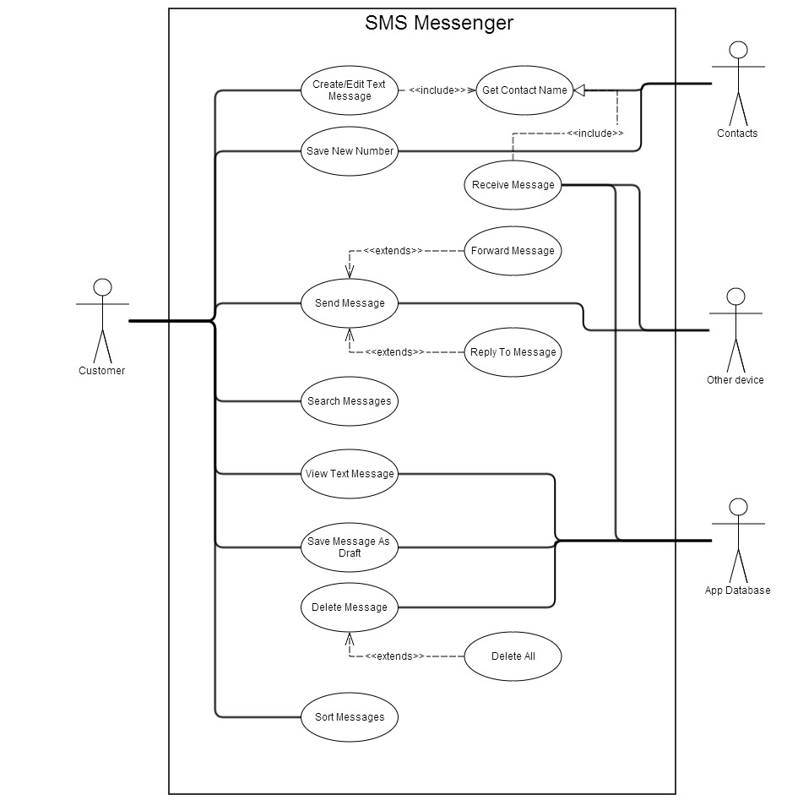
The Design

Slide 3
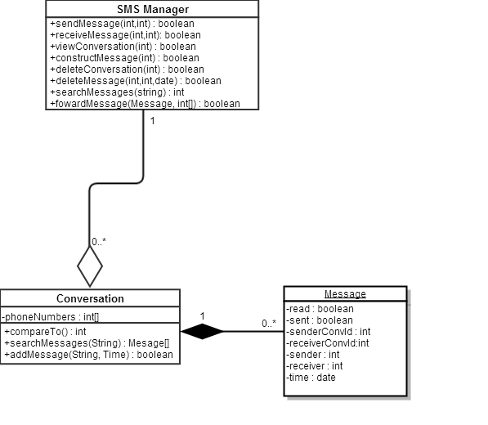
The Design Original Case Diagram

Slide 4
The Design (breaking it down)
Kept the dependencies to a minimum

Slide 5
The Features (What can our app do?)
Create, Send and Receive Messages
Auto-create, view and manage conversations
Contact Information tie in to Messages using Phone’s Contacts
Extra Features:
Zoom in and out of Message View and Conversation View
Search Conversations for a message with user specified contact or search string

Slide 6
The Features Send And Receive Messages

Slide 7
The Features Conversation View

Slide 8
The Features Contact Info Tie In

Slide 9
The Features Zoom!

Slide 10
The Features Search Messages!

Slide 11
The Look

Slide 12
Challenges along the way
The Android API
Team Work Distribution
Testing the logic

Slide 13
Challenges along the way The Android API
Android API Learning Curve
Who’s good at what?
The SMS Messenger Framework
Dealing with tough issues

Slide 14
What we learned! The Android API
Yay for a framework!
The SMS Framework was built by Michael Madrigral. If it wasn’t for him it would have been a much slower start.
It did add a little learning curve since existing code was already there but nothing intricate enough to cause any issues.
Android Learning Curve?
Slow but once you got the gist it wasn’t difficult to integrate new UI and logic.
The API documentation and online examples are everywhere (but the API documentation was the best reference.

Slide 15
Challenges along the way Testing
Who knows how to unit test!?
What is junit?
What do we unit test?
The logic only?
The features?

Slide 16
What we learned! Testing
The intuition of what to test relies on knowing what the logic does!
The Android Junit Testing Capability
http://developer.android.com/tools/testing/index.html
http://robolectric.org/
Testing the concrete logic
Learned the power of changing code and quickly testing the logic to make sure it still functions!

Slide 17
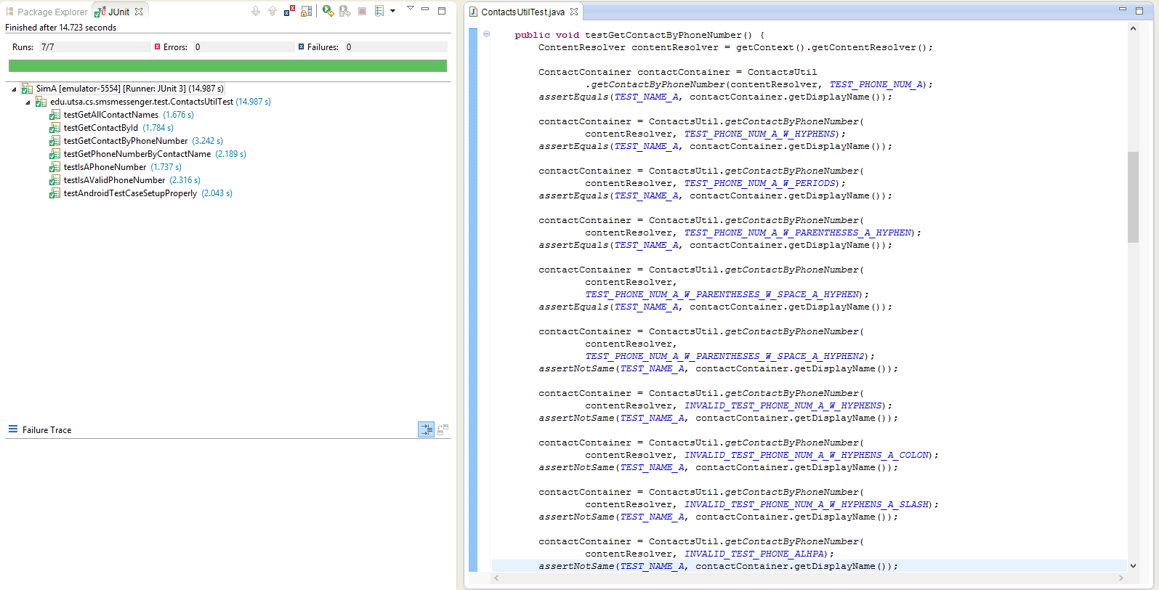
What we learned! Testing(JUnit example)

Slide 18
Challenges along the way Many ways to attack a problem
Coding by example
Too many examples online!
What’s correct, what’s optimal?
Illogical Android code
What’s an “Intent Leak”?
Perfect timing issues

Slide 19
What we learned! Many ways to attack a problem
Best examples are in the API itself
ex: http://developer.android.com/reference/android/provider/ContactsContract.PhoneLookup.html
Take your time understanding what does what and how it does it.
Don’t settle for the first example you find online!

Slide 20
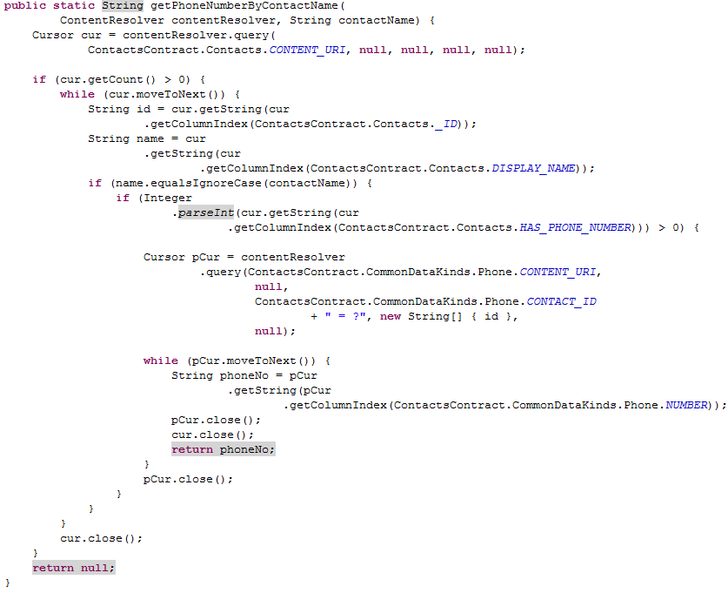
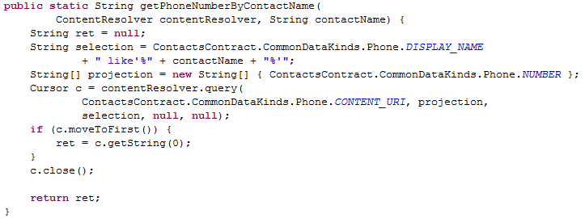
What we learned! Many ways to attack a problem
Slow Approach
The Fast Approach

Slide 21
What we learned!

